Slide 1
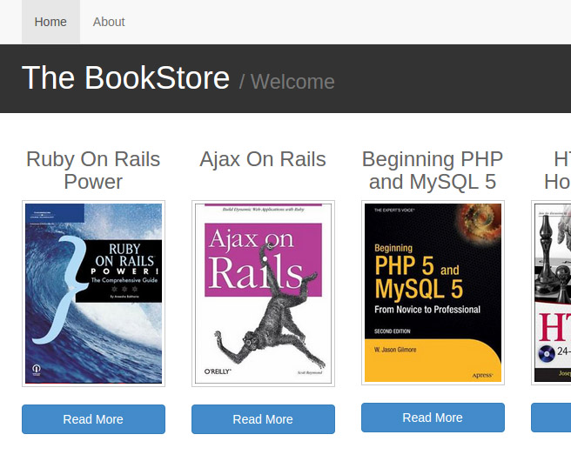
Projects Using Ruby on Rails
Project 1 Intro – BookStore

Slide 2
Project Description & Features
Browse books by category
Books will have authors and publishers
Boostrap layout
Books, categories, authors and publishers can be added from the frontend
Books, categories, authors and publishers can be updated and deleted from the frontend

Slide 3
Project Sections
Section 1: Project Introduction
Section 2: Rails & MySQL Setup
Section 3: Controllers & Views
Section 4: Application layout
Section 5: Models & Databases
Section 6: Creating Books
Section 7: Editing & Deleting Books
Section 8: Editing & Deleting Other Resources

Slide 4
What You’ll Learn
Rails application setup
MySQL database integration
MVC framework fundamentals
CRUD operations in Rails
Layouts with Bootstrap
RESTful routing

Slide 5
Let’s Do It!
Let’s go code!

